Slide 1

Psychopharmacology: Drugs, the Brain, and Behavior
by Meyer, Farrar, Biezonski, Yates

Slide 2
Chapter 18
Affective Disorders: Antidepressants and Mood Stabilizers
18.1 Characteristics of Affective Disorders
18.2 Neurochemical Basis of Affective Disorders
18.3 Therapies for Affective Disorders

Slide 3
Chapter 18
Learning Objectives (1 of 3)
18.1.1 Describe the general psychological, behavioral, and physical manifestations of affective disorders, including major depression and bipolar disorder.
18.1.2 Detail the risk factors for developing affective disorders, including the role of heredity, stress, and circadian rhythms, and the emerging role of the gut–brain axis.
18.1.3 Describe the animal models of affective disorders used in research.

Slide 4
Chapter 18
Learning Objectives (2 of 3)
18.2.1 Describe the monoamine hypothesis of affective disorders, and the potential roles of serotonin, norepinephrine, and dopamine in disorder pathophysiology.
18.2.2 Explain how cross-modulation between the serotonergic and noradrenergic systems may underlie the therapeutic effects of antidepressant treatment.
18.2.3 Detail the known neurobiological correlates of affective disorders.

Slide 5
Chapter 18
Learning Objectives (3 of 3)
18.3.1 Describe the mechanisms of action, therapeutic efficacy, and side-effect profiles of the three major classes of drugs used to treat depression: MAOs, TCAs, and SSRIs/SNRIs.
18.3.2 Describe third-generation therapies that alleviate depression through distinctive mechanisms of action, including ketamine and galanin agonists.

Slide 6
Characteristics of Affective Disorders (1 of 12)
DSM-5: Two types of affective disorder
Both characterized by extreme and inappropriate exaggeration of mood (affect)
Major depression: recurring episodes of dysphoria and negative thinking; reflected in behavior
Bipolar disorder: cyclic mood swings from depression to mania
Notes:
Instructor Notes:

Slide 7
Characteristics of Affective Disorders (2 of 12)
Major depression damages the quality of life
Reactive depression: response to situations such as loss of a loved one
Clinical depression:
  Loss of interest in everything
  Inability to experience pleasure (anhedonia)
  Feelings of hopelessness, worthlessness, sadness, guilt, desperation
  Loss of appetite and sexual desire, insomnia, fatigue
  Thoughts of suicide
Notes:
Instructor Notes:

Slide 8
Characteristics of Affective Disorders (3 of 12)
Major depression damages the quality of life
Extensive overlap of depression with anxiety disorder and alcohol dependence
Comorbidity predicts more severe symptoms
Episodes usually recur throughout life
Risk of depression is higher for women
Incidence has increased, and age of onset has decreased, since 1955
Notes:
Instructor Notes:

Slide 9
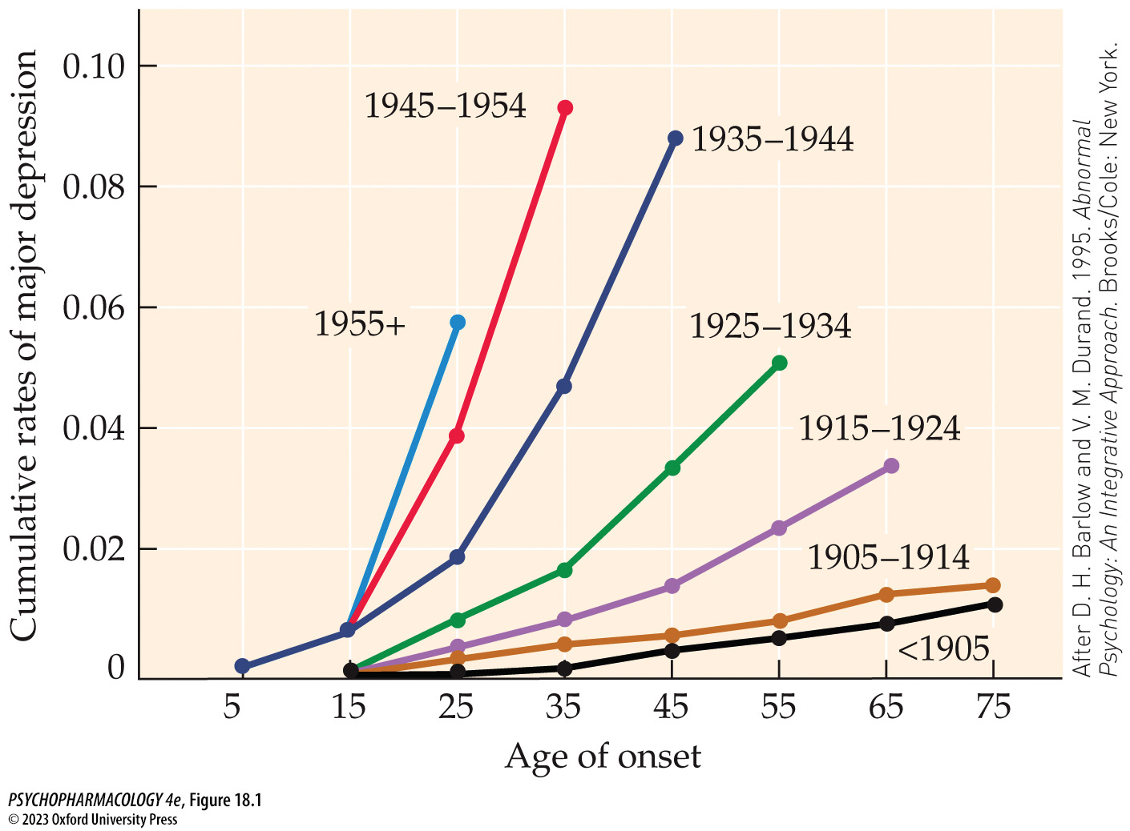
FIGURE 18.1 Age of onset of major depression
Notes:
FIGURE 18.1 Age of onset of major depression
Americans are developing major depression at higher rates and younger ages than previously, according to this analysis of data. The study evaluated 18,244 people at five sites, grouped in cohorts on the basis of year of birth. Cross-cultural surveys indicate a similar phenomenon worldwide. (After D. H. Barlow and V. M. Durand. 1995. Abnormal Psychology: An Integrative Approach. Brooks/Cole: New York.)

Slide 10
Characteristics of Affective Disorders (4 of 12)
In bipolar disorder, moods alternate between mania and depression
Manic individuals feel faultless, full of fun, talkative, energetic; need for sleep significantly reduced
In some, primary mood is irritability, belligerence, and impatience
Behavior: reckless driving, buying sprees, foolish business deals, sexual indiscretions
Notes:
Instructor Notes:

Slide 11
Characteristics of Affective Disorders (5 of 12)
Risk factors for mood disorders are biological and environmental
Evidence for a genetic contribution to affective disorders
  Adoption studies
  Twin studies: 65% concordance rate for identical twins; 80% for bipolar disorder
  Linkage studies: no single gene for affective disorders; many vulnerability genes may each contribute only a small amount
Notes:
Instructor Notes:

Slide 12
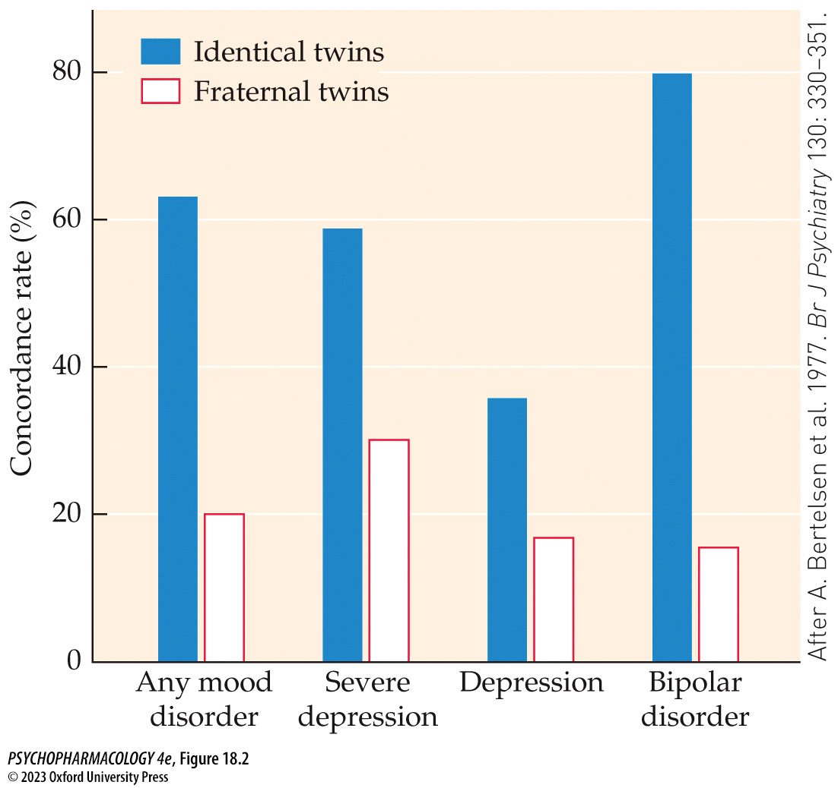
FIGURE 18.2 Concordance rates for mood disorders among identical and fraternal twins
Notes:
FIGURE 18.2 Concordance rates for mood disorders among identical and fraternal twins
Identical twins are far more likely to share mood disorders than are fraternal twins, especially in the case of bipolar disorder. Concordance for clinical depression depends to some extent on severity. In this case, severe depression is defined as three or more episodes of depression. Data were derived from 110 pairs of twins. (After A. Bertelsen et al. 1977. Br J Psychiatry 130: 330–351.)

Slide 13
Characteristics of Affective Disorders (6 of 12)
Risk factors for mood disorders are biological and environmental
Stress: mediated by the hypothalamic–pituitary–adrenal (HPA) axis
Many depressed patients have elevated cortisol levels and an abnormal circadian rhythm in cortisol secretion
Early life stress apparently alters the set point of the HPA axis, making it permanently overly responsive
Failure to respond to dexamethasone challenge
Notes:
Instructor Notes:

Slide 14
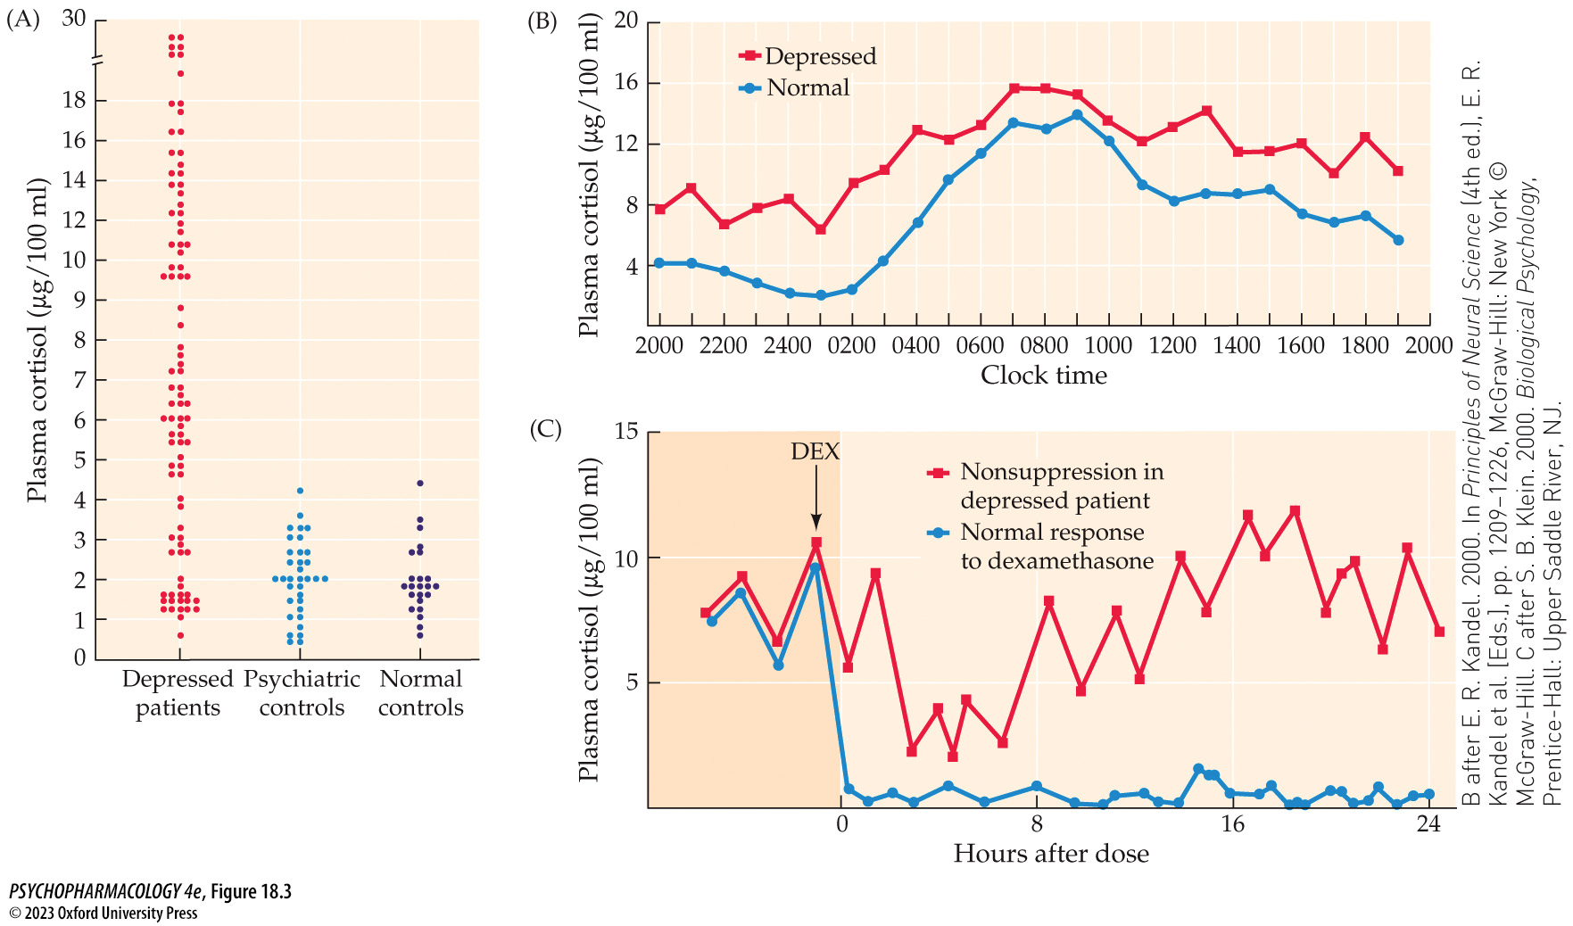
FIGURE 18.3 Abnormalities in glucocorticoids
Notes:
FIGURE 18.3 Abnormalities in glucocorticoids
(A) Many (but not all) depressed patients have elevated cortisol levels compared with controls. Each dot represents a single individual. (B) Differences exist in circadian changes in blood cortisol levels between depressed patients and healthy controls. The measures were made each hour over a 1-day period. The decline in cortisol that normally occurs in the early morning and evening occurs to a lesser extent in depressed patients. (C) Depressed individuals fail to respond with reduced cortisol levels after injection with 1 mg dexamethasone (DEX). The injected glucocorticoid also normally reduces both CRF release from the hypothalamus and pituitary release of ACTH. (B after E. R. Kandel. 2000. In Principles of Neural Science (4th ed.), E. R. Kandel et al. [Eds.], pp. 1209–1226, McGraw-Hill: New York © McGraw-Hill. C after S. B. Klein. 2000. Biological Psychology, Prentice-Hall: Upper Saddle River, NJ.)

Slide 15
Characteristics of Affective Disorders (7 of 12)
Risk factors for mood disorders are biological and environmental
Biological rhythms
  Abnormal sleep cycles
  Biological clocks of those with depression may be “phase shifted”
  Bipolar disorder also includes altered sleep rhythms
      Sleep deprivation can trigger an episode of mania
      Many other circadian rhythms also disturbed
Notes:
Instructor Notes:

Slide 16
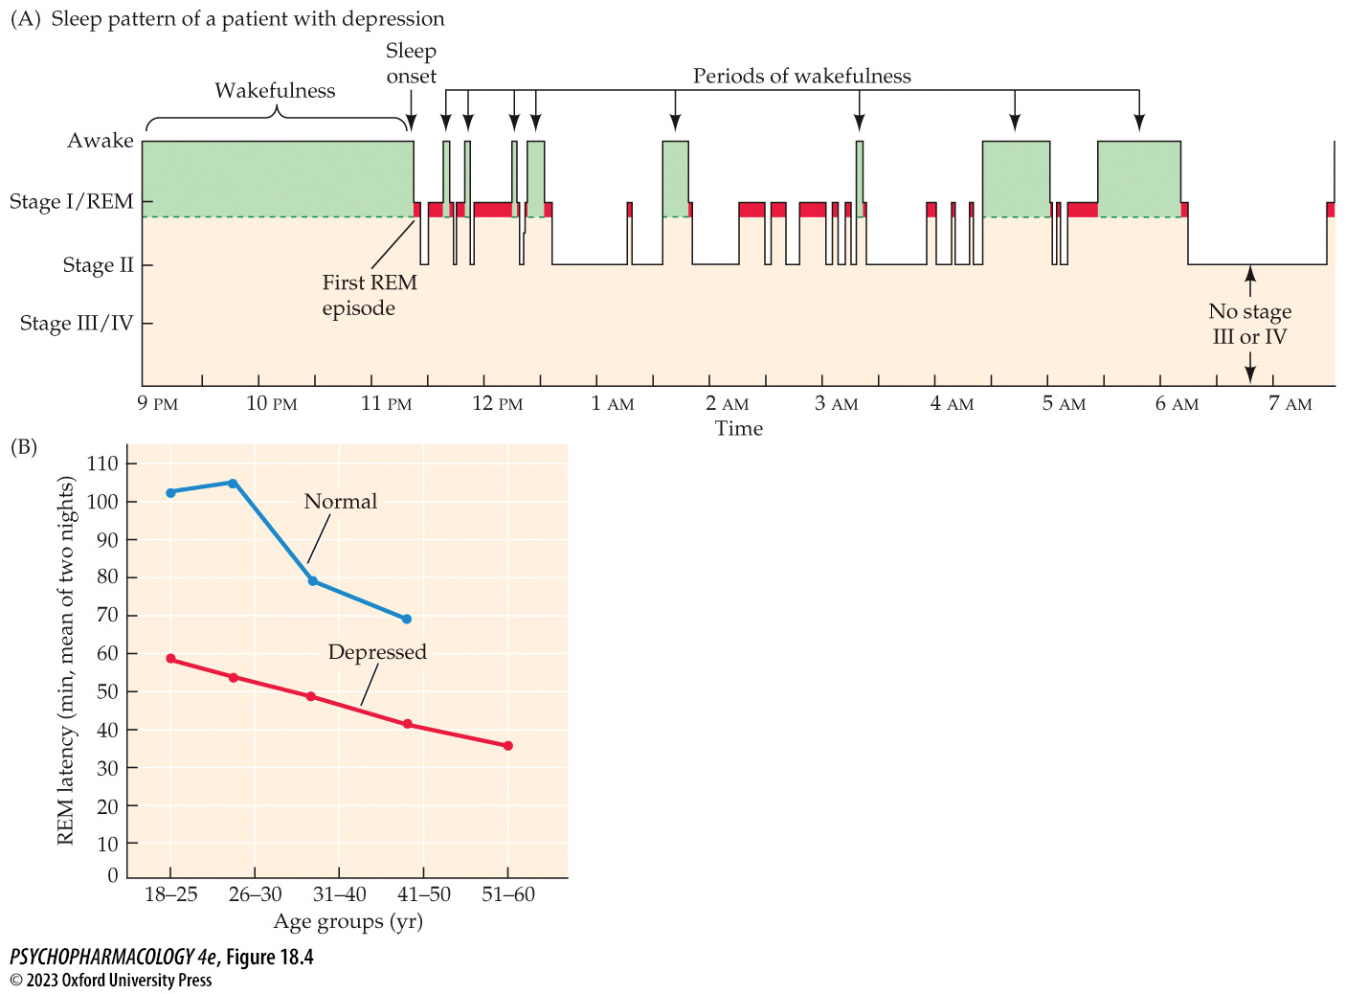
FIGURE 18.4 Altered sleep architecture in depression
Notes:
FIGURE 18.4 Altered sleep architecture in depression
(A) In depressed patients, the onset of sleep is delayed and REM periods (colored red) get shorter as the night goes on rather than longer, which is typical in healthy adults. Also, notice the many awakenings that occur during the night because of failure to reach deep sleep (stages III and IV). (B) REM episodes begin sooner after the onset of sleep in depressed than in nondepressed individuals at every age.

Slide 17
Characteristics of Affective Disorders (8 of 12)
Risk factors for mood disorders are biological and environmental
Gut-brain axis: gut bacteria can directly and indirectly impact CNS function though interaction with the vagus cranial nerve
Mice lacking intestinal bacteria exhibit a heightened response to stress through sensitization of the HPA axis
Different bacterial flora profiles have been associated with a variety of psychiatric symptoms
Notes:
Instructor Notes:

Slide 18
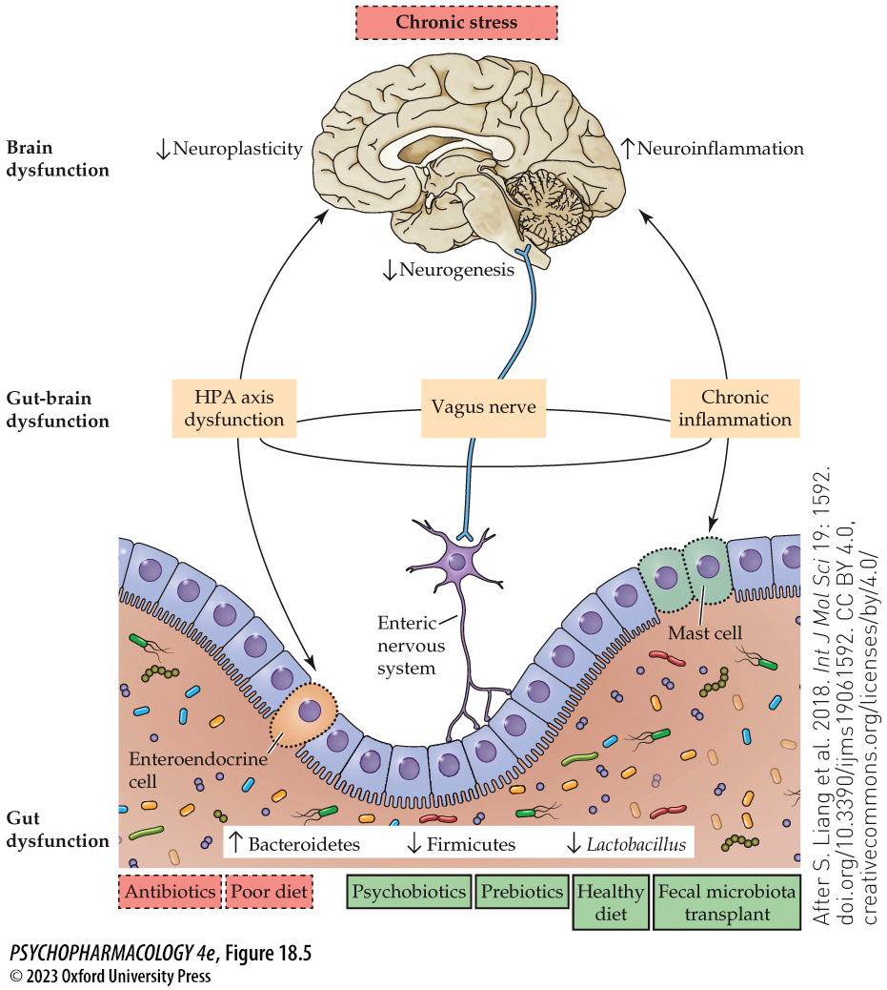
FIGURE 18.5 The potential involvement of the gut–brain axis in the pathophysiology of depression
Notes:
FIGURE 18.5 The potential involvement of the gut–brain axis in the pathophysiology of depression
Schematic shows how chronic stress, antibiotics, and poor diet (dashed outlines) may impact the enteric nervous system (ENS) and its interactions with the brain through the HPA axis, the vagus nerve, and chronic inflammation. This can lead to brain dysfunctions such as decreased neuroplasticity, neurogenesis, and neuroinflammation as seen in animal models of depression as well as in patients. Therapies such as treatment with pre/probiotics, fecal transplants from healthy donors, and healthy diet (heavy solid outlines) have the potential to mitigate these dysfunctions and improve the symptoms of depression in patients. (After S. Liang et al. 2018. Int J Mol Sci 19: 1592. doi.org/10.3390/ijms19061592. CC BY 4.0, creativecommons.org/licenses/by/4.0/)

Slide 19
Characteristics of Affective Disorders (9 of 12)
Animal models of affective disorders
Modeling complex psychiatric disorders poses multiple challenges
Many tests that predict effective antidepressant treatment in rodents don’t translate to humans
Animal models usually reflect only one or a few behavioral symptoms
Notes:
Instructor Notes:

Slide 20
Characteristics of Affective Disorders (10 of 12)
Animal models of bipolar disorder
Few models of the mania phase; even fewer of the cycling episodes
Several are based on altered circadian rhythms
Sleep deprivation-induced mania in rodents lasts about 30 minutes and can be reduced by lithium
Notes:
Instructor Notes:

Slide 21
Characteristics of Affective Disorders (11 of 12)
Animal models of bipolar disorder
Genetic models target circadian rhythms:
  CLOCK knockout mice show manic-like behaviors
  Overexpression of glycogen synthase kinase-3 (GSK-3)
Rodent models show some similarities with human patients, but also differences
Notes:
Instructor Notes:

Slide 22
Characteristics of Affective Disorders (12 of 12)
CLICKER QUESTION 1
If inheritance plays a role in the risk of developing an affective disorder, the concordance rate will be highest in
fraternal twins.
identical twins.
non-twin immediate family members.
Notes:
Instructor Notes:
Correct answer: b

Slide 23
Review of Learning Objectives (1 of 3)
18.1.1 Describe the general psychological, behavioral, and physical manifestations of affective disorders, including major depression and bipolar disorder.
18.1.2 Detail the risk factors for developing affective disorders, including the role of heredity, stress, and circadian rhythms, and the emerging role of the gut–brain axis.
18.1.3 Describe the animal models of affective disorders used in research.

Slide 24
Neurochemical Basis of Affective Disorders (1 of 12)
Monoamine hypothesis: reduced level of monoamines (DA, NE, 5-HT) in the CNS is responsible for depressed mood
  Depression is associated with low levels of monoamines
  Mania coincides with excess monoamine activity
Model is too simplistic, but it engendered much research and drug development.
One weakness: discrepancy in time between rapid increase in monoamines by antidepressant drugs and the slow onset of clinical effects over several weeks
Notes:
Instructor Notes:

Slide 25
Neurochemical Basis of Affective Disorders (2 of 12)
Serotonin dysfunction contributes to mood disorders
5-HT function indicated by metabolite 5-HIAA levels
  Low levels are found in CSF and postmortem brains of depressed individuals
Tryptophan hydroxylase and 5-HT receptor knockout mice have depression-like symptoms
Tryptophan depletion challenge: tryptophan-deficient diet causes depression in individuals with family history, or relapse in patients on antidepressant drugs
Notes:
Instructor Notes:

Slide 26
Neurochemical Basis of Affective Disorders (3 of 12)
Serotonin dysfunction contributes to mood disorders
A polymorphism in the serotonin reuptake transporter (SERT) gene may contribute to development of depression
  Stress interaction: short allele + stress = greater risk of depression, but studies are inconclusive
Receptor binding studies in post-mortem brain samples show increased density of 5-HT receptors in unmedicated depressed patients (upregulation)
Notes:
Instructor Notes:

Slide 27
Neurochemical Basis of Affective Disorders (4 of 12)
Serotonin dysfunction contributes to mood disorders
Most antidepressants increase 5-HT by blocking reuptake through SERT or inhibiting MAO, but acutely, autoreceptors reduce 5-HT synthesis
Chronic treatment results in autoreceptor downregulation – explains delay in therapeutic onset
Presynaptic 5-HT_{1A} autoreceptors appear to play an important role in depression
Efficacy of fluoxetine may depend on level of pretreatment 5-HT function and stress level of the environment
Notes:
Instructor Notes:

Slide 28
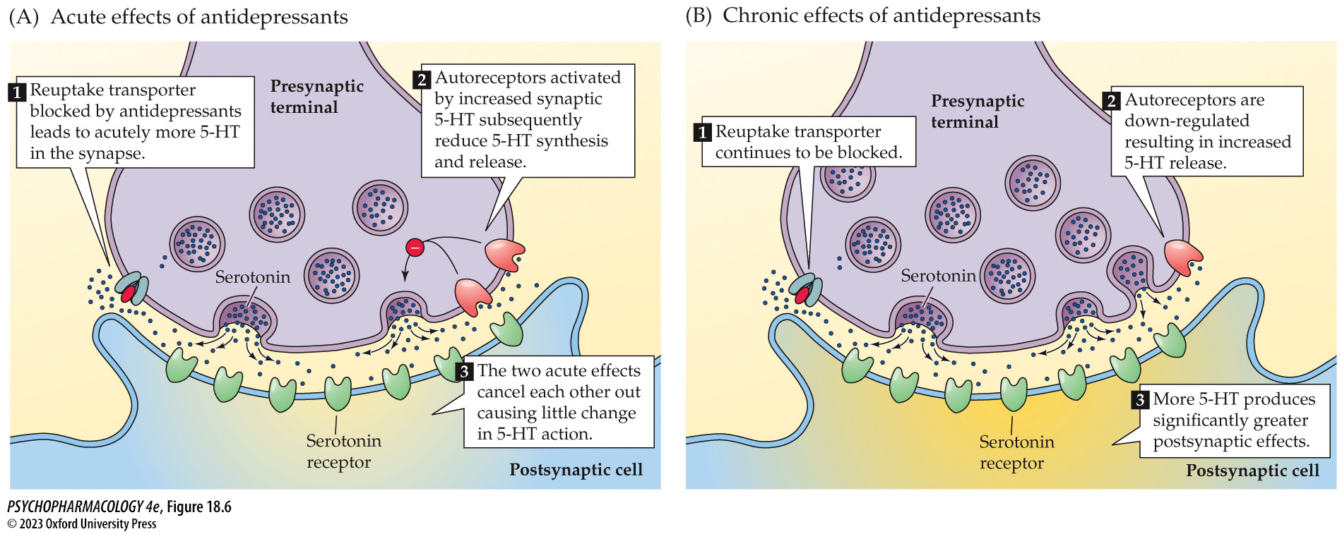
FIGURE 18.6 Effects of anti­depressants on serotonergic cells
Notes:
FIGURE 18.6 Effects of anti­depressants on serotonergic cells
(A) The initial effects of reuptake blockade include increased 5-HT in the synapse and activity at both postsynaptic receptors and autoreceptors. Autoreceptor activation reduces the rate of firing of the cell as well as the rate of synthesis and release of 5-HT and subsequently also reduces the rate of formation of 5-HIAA. (B) With repeated administration, the autoreceptors become less sensitive, and their inhibition of serotonergic neurons decreases, which leads to an increase in 5-HT function and 5-HIAA. However, the increase in 5-HT is perhaps just the initial step, and subsequent changes downstream, postsynaptically, are required, including hippocampal neuro­genesis and functional remodeling of corticolimbic circuits.

Slide 29
Neurochemical Basis of Affective Disorders (5 of 12)
Norepinephrine activity is altered by antidepressants
Studies are inconclusive
Many, but not all, antidepressant treatments lead to down-regulation of β-receptors
Untreated depressed individuals and those with bipolar disorder had increased density of α₂-autoreceptors
Notes:
Instructor Notes:

Slide 30
Neurochemical Basis of Affective Disorders (6 of 12)
Norepinephrine and serotonin modulate one another
Serotonin–norepinephrine hypothesis of depression
Consistent chronic effects of antidepressants: down-regulation of β- and 5-HT₂ receptors and enhanced response to 5-HT
Anatomical and functional interactions exist between the noradrenergic neurons originating in the LC and the serotonergic neurons in the raphe nuclei
Notes:
Instructor Notes:

Slide 31
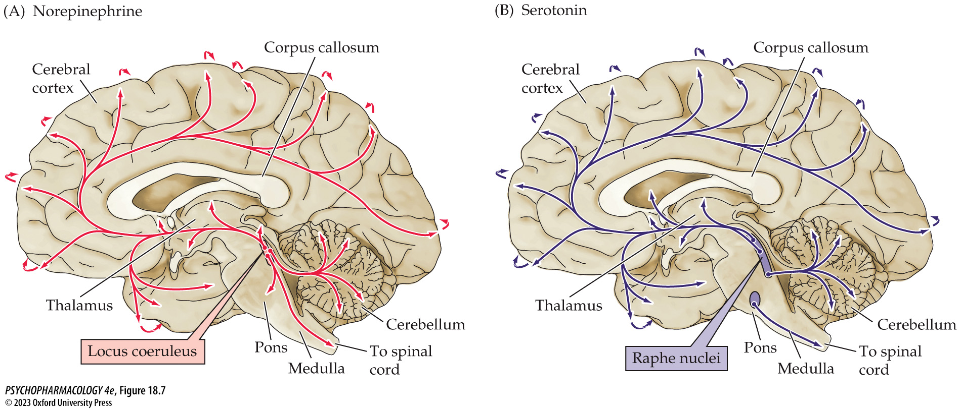
FIGURE 18.7 Two monoamine pathways in the human brain
Notes:
FIGURE 18.7 Two monoamine pathways in the human brain
This schematic diagram shows noradrenergic pathways originating in the locus coeruleus (A) and serotonergic pathways originating in the raphe nuclei (B). The overlapping nature and interaction of the two neurotransmitter systems are very apparent.

Slide 32
Neurochemical Basis of Affective Disorders (7 of 12)
Neurobiological models of depression
Neuroimaging studies show reduced volume of hippocampus and other brain areas in depressed people plus abnormal levels of metabolic activity
Depressed individuals have highly coupled connectivity between nodes in the default-mode network (DMN), which functions in introspective thinking.
DMN is anticorrelated with the salience network
Notes:
Instructor Notes:

Slide 33
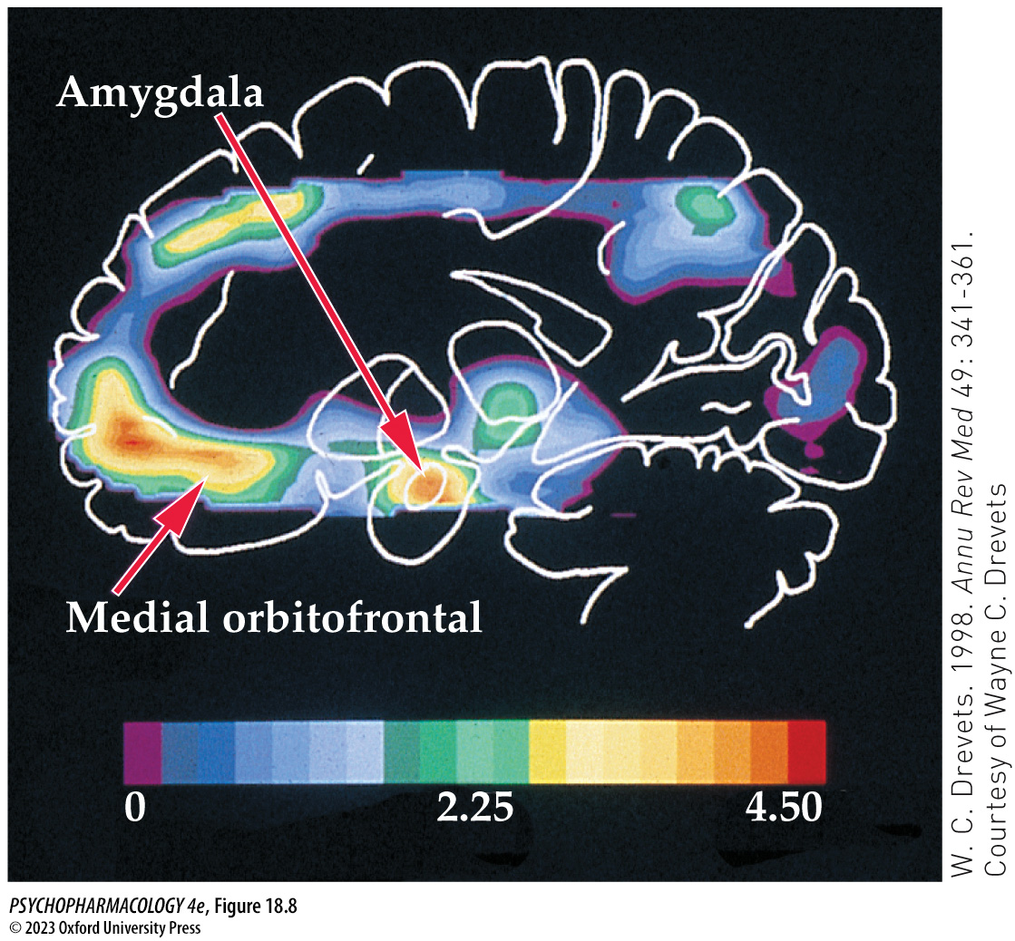
FIGURE 18.8 PET scan of blood flow in the brain of a patient with unipolar depression
Notes:
FIGURE 18.8 PET scan of blood flow in the brain of a patient with unipolar depression
Increased metabolic activity occurs in the amygdala and the medial orbitofrontal cortex. Activation is shown in red and orange.

Slide 34
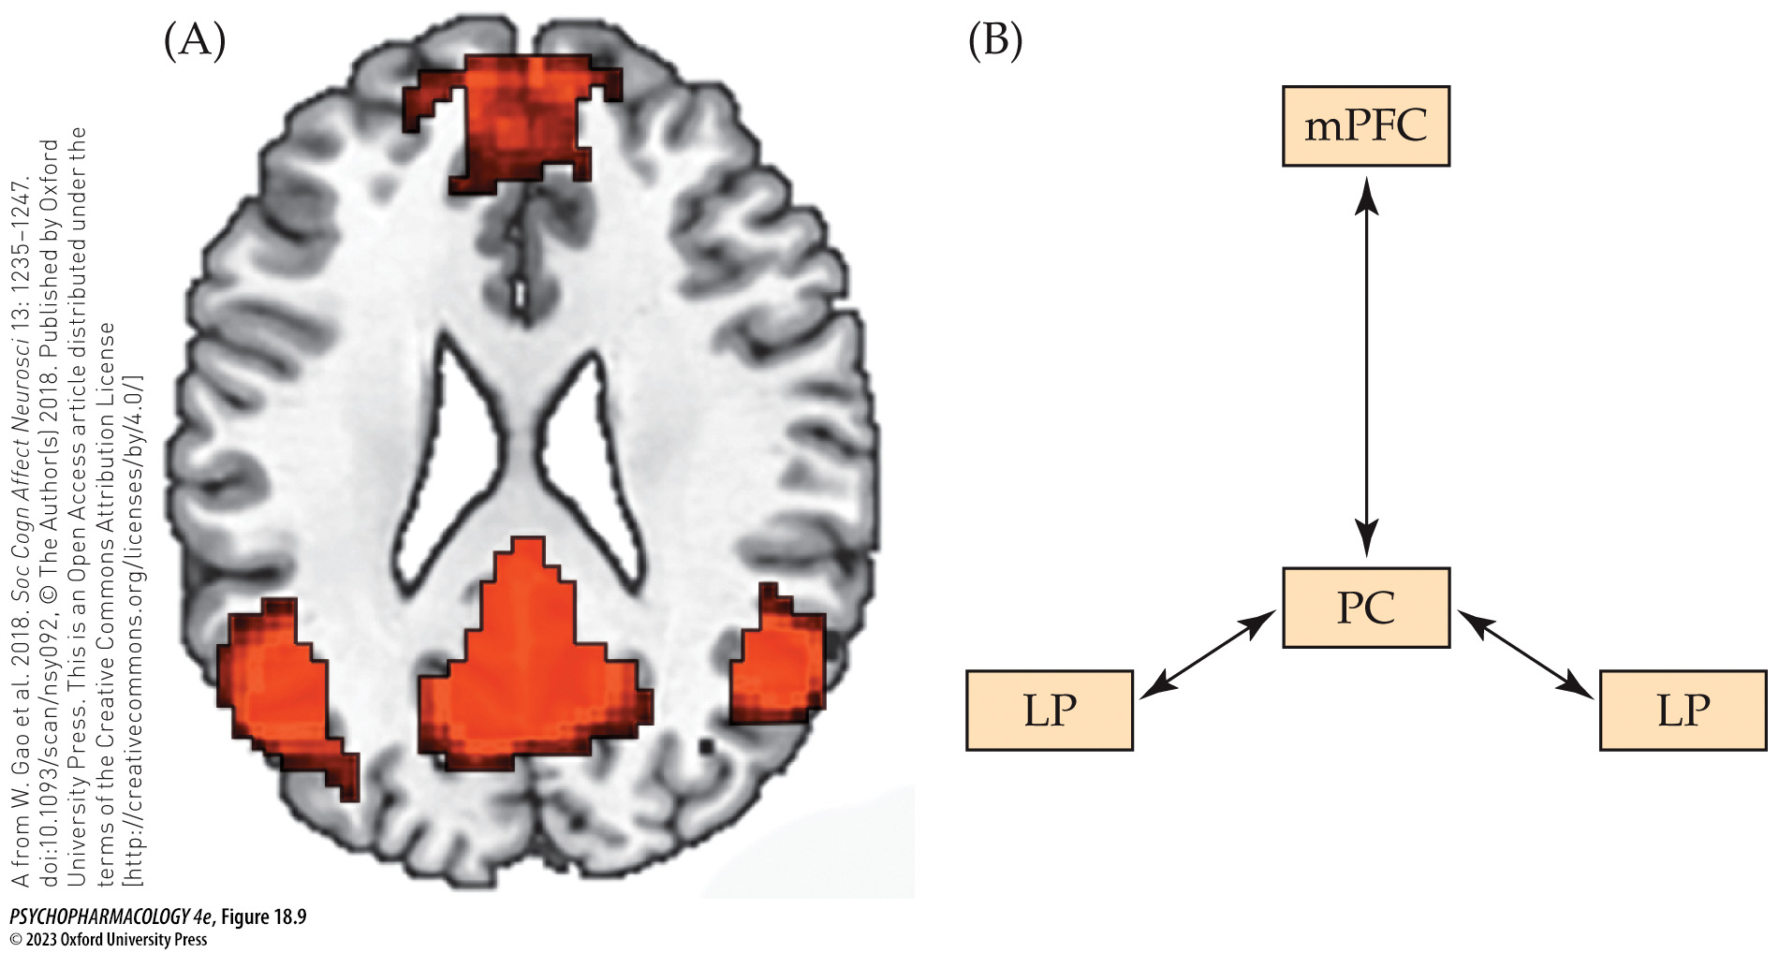
FIGURE 18.9 The default-mode network (DMN) drives cognitive rumination
Notes:
FIGURE 18.9 The default-mode network (DMN) drives cognitive rumination.
(A) fMRI image shows functional connectivity of the three core regions of the DMN: the medial prefrontal cortex (mPFC), the precuneus (PC), and the left and right lateral parietal lobes (LP). DMN connectivity between these nodes is schematically depicted in (B).

Slide 35
Neurochemical Basis of Affective Disorders (8 of 12)
Neurobiological models of depression
Stress and prolonged hypersecretion of CRF, ACTH, and glucocorticoids damages dendritic branching and spines in the hippocampus and PFC
Elevated cortisol reduces the formation of new hippocampal cells (neurogenesis)
Neurotropic hypothesis suggests these things may be due to low BDNF; antidepressants may prevent low BDNF
Notes:
Instructor Notes:
BDNF (brain-derived neurotrophic factor).

Slide 36
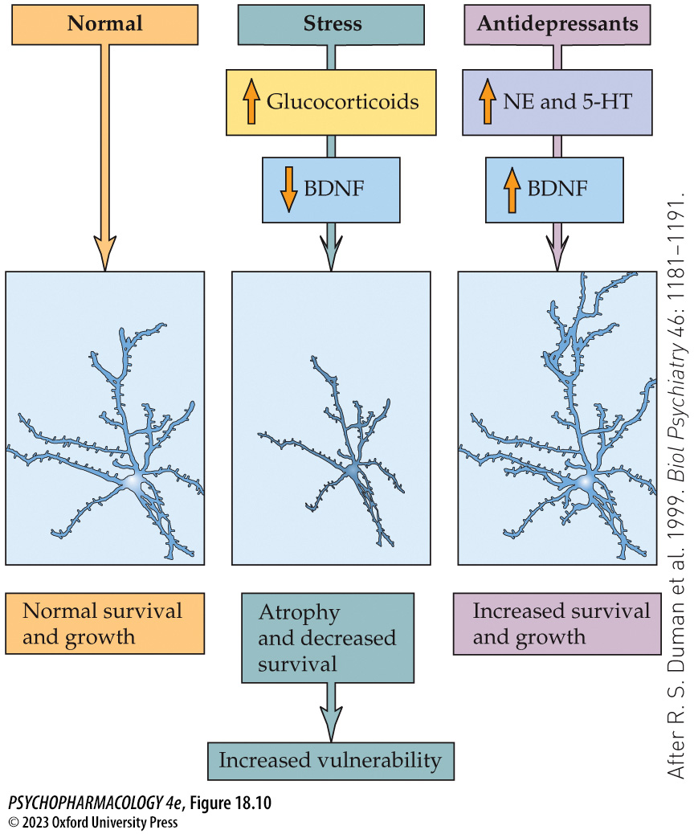
FIGURE 18.10 Effect of stress and antidepressant treatment on BDNF in hippocampal cells
Notes:
FIGURE 18.10 Effect of stress and antidepressant treatment on BDNF in hippocampal cells
The box on the left shows a typical hippocampal cell in the CA3 area. Chronic stress (center) elevates glucocorticoids and decreases BDNF, which may be responsible for the loss of dendritic trees and may make the cells more vulnerable to a variety of detrimental factors. Chronic antidepressant treatment (right) not only alters monoamine transmission but also increases BDNF. BDNF may protect the cells from further damage and may help repair those already damaged. (After R. S. Duman et al. 1999. Biol Psychiatry 46: 1181–1191.)

Slide 37
Neurochemical Basis of Affective Disorders (9 of 12)
Neurobiological models of depression
Evidence for BDNF in the etiology of depression includes:
  BDNF is low in the hippocampus and PFC of depressed patients post-mortem,
  A BDNF gene polymorphism may be associated with mood disorders
  Modifying BDNF gene expression in mice leads to depressive behaviors.
Notes:
Instructor Notes:

Slide 38
Neurochemical Basis of Affective Disorders (10 of 12)
BOX 18.1 THE CUTTING EDGE
Epigenetic Modifications in Psychopathology and Treatment
The gene for BDNF can be modified by chromatin remodeling (epigenetic change) that affects levels of gene expression
Chronic stress in mice causes long-lasting reductions in BDNF expression by increasing histone methylation, inducing a more “closed” chromatin state that reduces transcription
Reversed by antidepressants
Notes:
Instructor Notes:
sdsdfsd

Slide 39
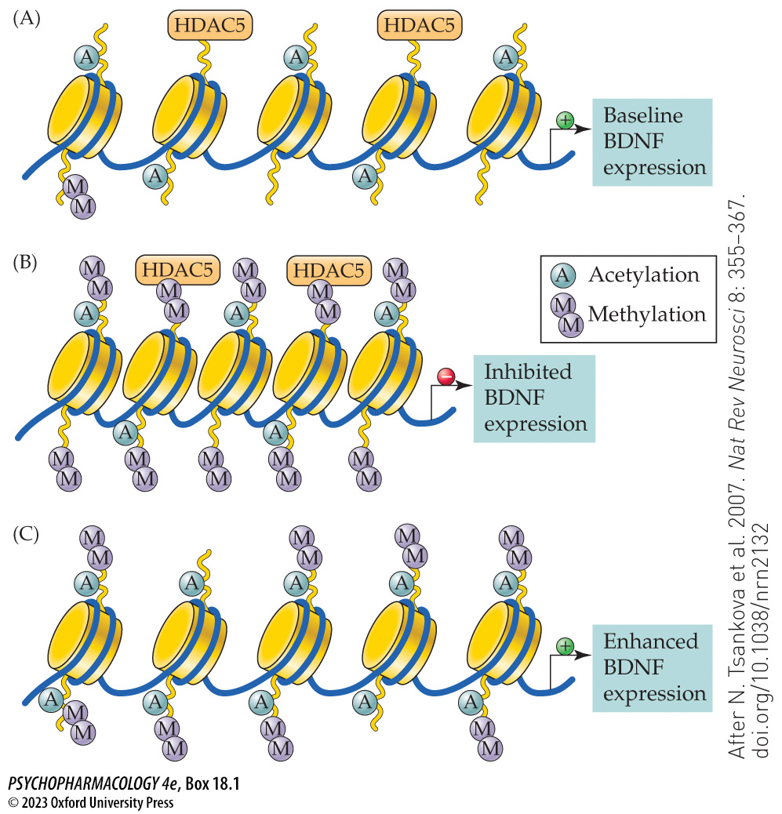
Box 18.1 The Cutting Edge: Epigenetic Modifications in Psychopathology and Treatment
Notes:
Box 18.1 The Cutting Edge: Epigenetic Modifications in Psychopathology and Treatment
Chromatin remodeling
(A) Under nonstress conditions, the chromatin of the BDNF gene has low levels of acetylation and virtually no methylation, providing a basal BDNF expression. (B) The histone methylation following prolonged episodes of defeat stress induces a tighter envelope of chromatin proteins and blocks BDNF gene expression. (C) Chronic antidepressant use increases acetylation without altering the chronic stress–induced methylation, which produces a “relaxation” of the repressed chromatin, encouraging transcription of the BDNF gene, which may be necessary for the antidepressant effects. HDAC5, histone deacetylase 5. (After N. Tsankova et al. 2007. Nat Rev Neurosci 8: 355–367. doi.org/10.1038/nrn2132)

Slide 40
Neurochemical Basis of Affective Disorders (11 of 12)
Neurobiological models of depression
Chronic antidepressants up-regulate the cAMP cascade, despite down-regulation of β-adrenergic and 5-HT receptors that are coupled to the cAMP cascade
This increases phosphorylated CREB and subsequent expression of BDNF
Enhancing the cAMP cascade by inhibiting PDE produced antidepressant effects in rodents.
Notes:
Instructor Notes:

Slide 41
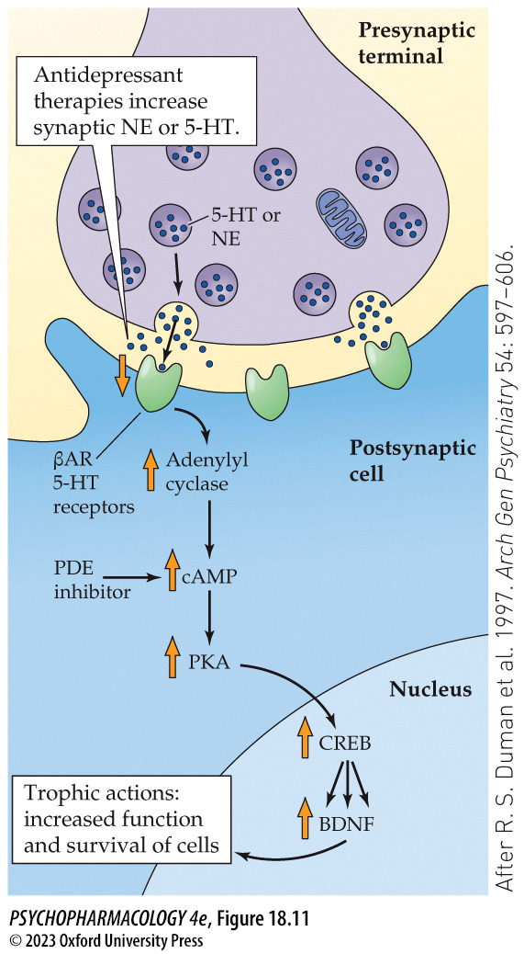
FIGURE 18.11 Up-regulation of second-messenger pathway by chronic antidepressant treatment
Notes:
FIGURE 18.11 Up-regulation of second-messenger pathway by chronic antidepressant treatment
The increase in NE and 5-HT caused by acute antidepressant treatment produces down-regulation of their receptors when treatment is chronic. In response to the reduction in receptors, the cAMP pathway is up-regulated, producing increases in adenylyl cyclase activity, cAMP, protein kinase A (PKA), and the transcription factor within the nucleus, CREB. CREB increases the synthesis of several proteins, including BDNF. βAR, β-adrenergic receptor; PDE, phosphodiesterase. (After R. S. Duman et al. 1997. Arch Gen Psychiatry 54: 597–606.)

Slide 42
Neurochemical Basis of Affective Disorders (12 of 12)
CLICKER QUESTION 2
The tryptophan depletion challenge can cause depressed mood in some cases because
excess tryptophan causes abnormal 5-HT function.
tryptophan is the precursor for 5-HIAA synthesis.
tryptophan is necessary for 5-HT synthesis.
Notes:
Instructor Notes:
Correct answer: c

Slide 43
Review of Learning Objectives (2 of 3)
18.2.1 Describe the monoamine hypothesis of affective disorders, and the potential roles of serotonin, norepinephrine, and dopamine in disorder pathophysiology.
18.2.2 Explain how cross-modulation between the serotonergic and noradrenergic systems may underlie the therapeutic effects of antidepressant treatment.
18.2.3 Detail the known neurobiological correlates of affective disorders.

Slide 44
Therapies for Affective Disorders (1 of 14)
Several classes of antidepressant drugs are effective in reducing, but not eliminating, the symptoms of affective disorders in about 2/3 of cases
No one drug is more effective than others; no way to predict patient’s response to a particular drug
Maximal effectiveness may not be achieved until 4 to 6 weeks of therapy
Total remission is rare; continued treatment prevents relapse
Notes:
Instructor Notes:

Slide 45
Therapies for Affective Disorders (2 of 14)
MAOIs are the oldest antidepressant drugs
MAO metabolizes monoamine neurotransmitters not contained in vesicles in presynaptic terminals
Inhibition of MAO increases amount of neurotransmitters available for release
But neuron adaptation involving change in receptor density or second-messenger function must play role in MAOI effects
Notes:
Instructor Notes:
Currently available MAOIs include phenelzine (Nardil), tranylcypromine (Parnate), and isocarboxazid (Marplan).

Slide 46
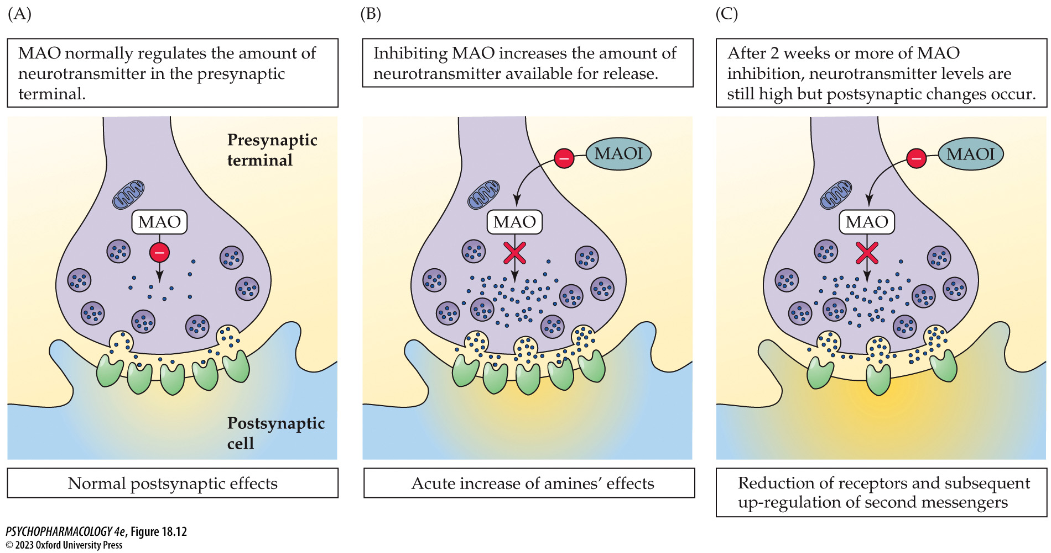
FIGURE 18.12 Acute and long-term effects of MAOIs on synaptic function
Notes:
FIGURE 18.12 Acute and long-term effects of MAOIs on synaptic function
(A) Presynaptic MAO degrades neurotransmitter molecules that are not in vesicles, to keep amines at “normal” levels. (B) MAOIs inhibit the enzyme, causing an elevation in available neurotransmitter for release, resulting in increased action at receptors. (C) After 10 days to 2 weeks of antidepressant treatment, the amount of neurotransmitter in the synapse is still elevated over control conditions, but neural adaptation has occurred: down-regulation of amine receptors and up-regulation of the cyclic adenosine monophosphate (cAMP) second-messenger system. Other antidepressant drugs produce similar adaptive changes in neurons.

Slide 47
Therapies for Affective Disorders (3 of 14)
MAOIs are the oldest antidepressant drugs
Side effects include changes in blood pressure, sleep disturbances, and overeating/weight gain
More dangerous effects:
  Elevated NE levels intensify drugs that enhance NE function, e.g., cocaine, cold medications
  Elevated levels of tyramine (normally metabolized by MAO) releases higher-than-normal stores of NE at nerve endings, causing dangerous increases in blood pressure
  Inhibition of other liver enzymes
Notes:
Instructor Notes:

Slide 48
Therapies for Affective Disorders (4 of 14)
TCAs block the reuptake of NE and serotonin
Tricyclic antidepressants (TCAs) bind to presynaptic transporter proteins, inhibiting reuptake of neurotransmitters, prolonging duration of transmitter action
Different TCAs have different NE and 5-HT reuptake-blocking potencies
Selective reuptake inhibitors have also been developed.
Acute increase in synaptic activity is the first step in antidepressant action; neuronal adaptation over time, is necessary
Notes:
Instructor Notes:
TCAs: Amitriptyline, Desipramine, Imipramine, Nortriptyline, Protriptyline, Trimipramine

Slide 49
Therapies for Affective Disorders (5 of 14)
TCAs block the reuptake of NE and serotonin
Side effects of TCAs
  Histamine receptor blockade causes sedation and
  Anticholinergic effects include dry mouth, constipation, dizziness, etc.
  α₁ blockade, coupled with NE reuptake-blocking, leads to potentially dangerous cardiovascular effects, including orthostatic hypotension, tachycardia, and arrhythmias
  Overdose: cardiovascular problems, delirium, convulsions, coma, death; low therapeutic index.
Notes:
Instructor Notes:

Slide 50
Therapies for Affective Disorders (6 of 14)
Second-generation antidepressants have different side effects
None are more effective than older drugs, and don’t have a more rapid onset
Selective serotonin reuptake inhibitors (SSRIs) block presynaptic 5-HT reuptake transporters more than NE transporters
Also used to treat panic and anxiety disorders, OCD, obesity, and alcohol use disorder
Notes:
Instructor Notes:
SSRIs include fluoxetine (Prozac), sertraline (Zoloft), and paroxetine (Paxil)

Slide 51
Therapies for Affective Disorders (7 of 14)
Second-generation antidepressants have different side effects
Side effect of SSRIs:
  Increased 5-HT function at some serotonergic receptors causes anxiety, movement disorders, muscle rigidity, nausea, headache, insomnia, sexual dysfunction
  Serotonin syndrome: potentially life-threatening effects when combined with other serotonergic agonists or drugs
  Can cause physical dependence
Notes:
Instructor Notes:
SSRIs include fluoxetine (Prozac), sertraline (Zoloft), and paroxetine (Paxil)

Slide 52
Therapies for Affective Disorders (8 of 14)
Second-generation antidepressants have different side effects
Dual NE/5-HT modulators (SNRIs): enhancing both NE and 5-HT function is more beneficial than enhancing only one
Mirtazapine blocks α₂-autoreceptors, increasing synaptic NE and α₂-heteroreceptors on serotonergic cells, increasing 5-HT release
  To reduce side effects, it blocks only selected 5-HT receptors.
Notes:
Instructor Notes:

Slide 53
Therapies for Affective Disorders (9 of 14)
Third-generation antidepressants have distinctive mechanisms of action
Currently in development and testing
CRF receptor antagonism and enhancement of the cAMP second-messenger system
Regulation of circadian dysfunctions by agomelatine
The NMDA receptor antagonist ketamine
Galanin agonists, tianeptine, and AMPA agonists.
Notes:
Instructor Notes:

Slide 54
Therapies for Affective Disorders (10 of 14)
Third-generation antidepressants have distinctive mechanisms of action
Ketamine effects last far longer than the drug’s short half-life.
Ketamine probably enhances BDNF-stimulated neurogenesis and elaboration of dendritic spine growth
  Mechanism is unclear; it may be rapid activation of the mTOR signaling cascade
Multiple potential mechanisms may explain ketamine’s rapid onset of antidepressant effects
Notes:
Instructor Notes:

Slide 55
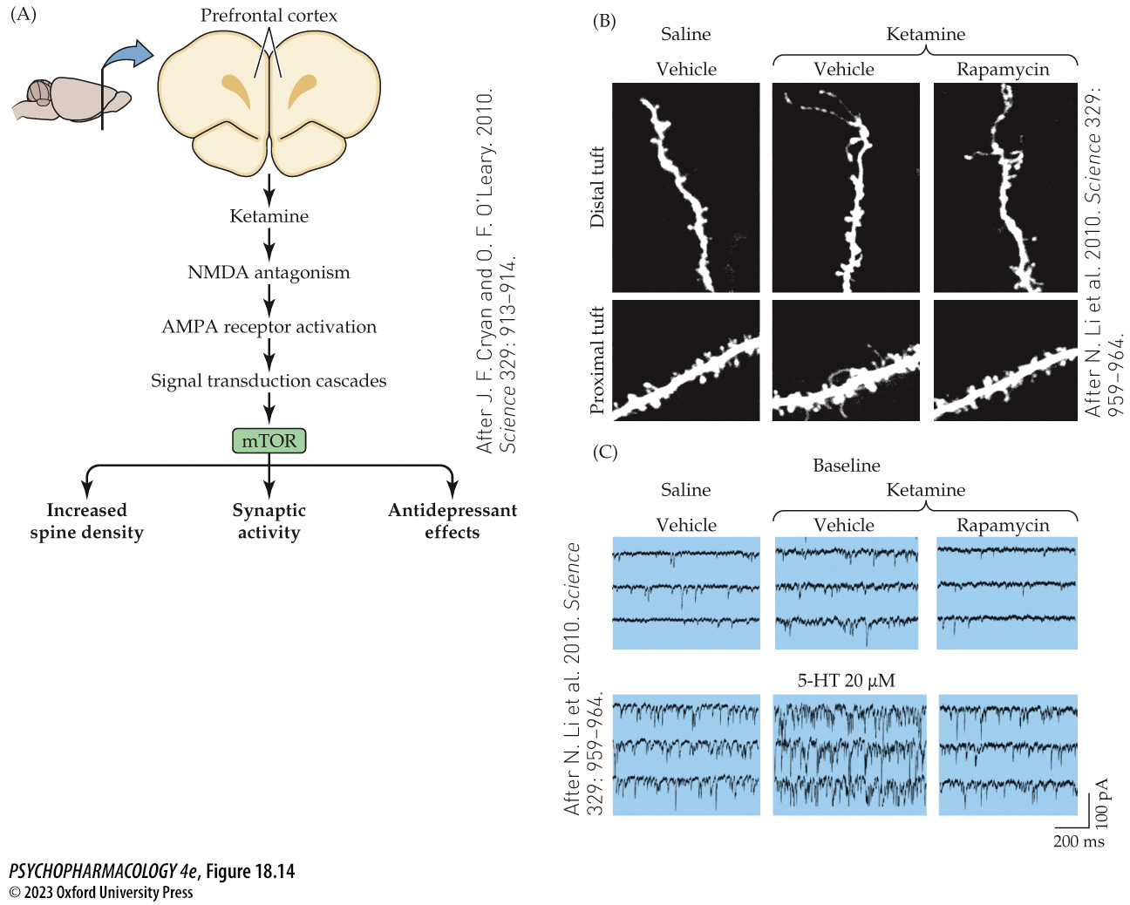
FIGURE 18.14 Ketamine’s rapid activation of mTOR
Notes:
FIGURE 18.14 Ketamine’s rapid activation of mTOR
(A) The cascade of events beginning with intravenous injection of ketamine inhibits NMDA receptor function but additionally enhances glutamate activation of AMPA receptors. Multiple signal transduction cascades mediate the activation of the protein kinase mTOR. The action of mTOR in turn increases dendritic spine density, enhances synaptic activity by modifying synaptic proteins, and produces rapid antidepressant effects. A reciprocal relationship between mTOR and BDNF forms a positive feedback loop (not shown). (B) Two-photon microscopy shows increased spine density on both distal and proximal segments of dendrites in medial prefrontal cortex (mPFC) pyramidal neurons 24 hours after ketamine administration, compared with control animals. There was an increase in large-diameter, more mature (mushroom) spines. The increase was prevented by the mTOR antagonist rapamycin. (C) Whole-cell voltage-clamp recordings show ketamine enhanced the 5-HT–induced excitatory postsynaptic currents in pyramidal cells of mPFC, 24 hours after ketamine injection. (A after J. F. Cryan and O. F. O’Leary. 2010. Science 329: 913–914. C after N. Li et al. 2010. Science 329: 959–964.)

Slide 56
Therapies for Affective Disorders (11 of 14)
Third-generation antidepressants have distinctive mechanisms of action
Nondrug therapy: An effective antidepressant treatment is physical exercise
  May depend on its ability to increase neurogenesis and dendritic re-sculpturing
  Animal studies suggest a role for the hormone adiponectin in this process.
Notes:
Instructor Notes:

Slide 57
Therapies for Affective Disorders (12 of 14)
Drugs for treating bipolar disorder stabilize the highs and the lows
Lithium: most effective treatment for bipolar disorder
  Eliminates or reduces manic episodes without causing depression or producing sedation
  Particularly effective in reducing suicide
  Mechanism: enhances 5-HT actions and reduces catecholamine activity; mood-stabilizing effects may be due to inhibition of GSK-3 regulation of circadian rhythms
  Side effects are mild
  Therapeutic index is very low; blood levels of lithium must be monitored regularly; toxic effects can be severe
Notes:
Instructor Notes:
Lithium carbonate: Carbolith, Eskalith

Slide 58
Therapies for Affective Disorders (13 of 14)
Drugs for treating bipolar disorder stabilize the highs and lows
Other therapies for bipolar disorder include anticonvulsants:
  Valproate (Depakote): as effective as lithium, different side effects
      Teratogenic
      Increases GABA levels by stimulating glutamic acid decarboxylase and inhibiting GABA transaminase
  Carbamazepine (Tegretol): as effective as lithium, different side effects
      Inhibits NE reuptake; acutely blocks and upregulates adenosine receptors
Notes:
Instructor Notes:

Slide 59
Therapies for Affective Disorders (14 of 14)
CLICKER QUESTION 3
Which class of antidepressant drugs elevates the amount of monoamine neurotransmitters available for release?
SSRIs
SNRIs
MAOIs
TCAs
Notes:
Instructor Notes:
Correct answer: c

Slide 60
Review of Learning Objectives (3 of 3)
18.3.1 Describe the mechanisms of action, therapeutic efficacy, and side-effect profiles of the three major classes of drugs used to treat depression: MAOs, TCAs, and SSRIs/SNRIs.
18.3.2 Describe third-generation therapies that alleviate depression through distinctive mechanisms of action, including ketamine and galanin agonists.

